Slide 1

WIPRO NGA Program – 25SUB4530_CP_JAVA
Capstone Project Presentation – 9th Feb & 10th Feb 2026
Project Title - Customer Feedback Management System
Presented by – Kancharla Deva Harshini
Kartik Angrish
www.rpsconsulting.in

Slide 2

Customer Feedback Management System
Introduction
Managing customer feedback manually can be difficult and inefficient. Many organizations struggle to collect, organize, and analyze customer opinions, which affects service quality and decision-making.
The Customer Feedback Management System is designed to solve this problem by providing a digital platform where users can submit structured feedback with ratings and comments in an organized manner.
The application offers a simple interface and real-time data storage, enabling administrators to easily monitor customer satisfaction and improve products and services effectively.
2024 - RPS Consulting all rights reserved

Slide 3
Customer Feedback Management System
Project Overview
The Customer Feedback Management System is a web application designed to collect, manage, and analyze customer feedback for products or services.
It enables organizations to:
Understand customer satisfaction
Improve service quality using real-time feedback
The system uses:
Angular frontend for feedback submission and dashboards
Spring Boot backend for REST APIs and business logic
Docker and Azure for scalable deployment
2024 - RPS Consulting all rights reserved

Slide 4
Customer Feedback Management System
Problem Statement
Many businesses face challenges in:
Collecting structured customer feedback efficiently
Analysing customer satisfaction trends
Managing feedback securely in one platform
Manual feedback systems are:
Error-prone
Time-consuming
Hard to scale
Hence, a centralized, web-based feedback system is required.
2024 - RPS Consulting all rights reserved

Slide 5
Customer Feedback Management System
Objectives
To collect structured customer feedback with ratings and comments
To store feedback securely in a database
To enable easy viewing and filtering of feedback
To improve customer satisfaction analysis
To validate user input and handle errors properly
To provide a user-friendly and efficient feedback management system
2024 - RPS Consulting all rights reserved

Slide 6
Customer Feedback Management System
System Architecture
The application follows a three-tier architecture to ensure scalability, maintainability, and clear separation of responsibilities:
Frontend (Angular):
Provides an interactive user interface for customers to submit feedback and for administrators to view and filter feedback through dashboards.
Backend (Spring Boot REST APIs):
Handles business logic, data validation, request processing, and communication between the frontend and the database.
Database (PostgreSQL / H2):
Stores customer details, product information, and feedback records securely in structured tables.
2024 - RPS Consulting all rights reserved

Slide 7
Customer Feedback Management System
Technology Stack
Frontend:
Angular
HTML, CSS, TypeScript
Backend:
Java
Spring Boot
Spring Data JPA
Database:
PostgreSQL (Production)
H2 (Development & Testing)
DevOps:
Docker
Azure App Service
2024 - RPS Consulting all rights reserved

Slide 8
Customer Feedback Management System
Core Functionalities
Allows customers to submit feedback with ratings and detailed comments
Displays all submitted feedback in an organized dashboard view
Enables filtering of feedback based on ratings for better analysis
Stores feedback securely and reliably in the database
Validates user input to ensure accurate data entry
Handles errors gracefully using proper exception handling mechanisms
2024 - RPS Consulting all rights reserved

Slide 9
Customer Feedback Management System
Backend Design
Backend follows layered architecture:
Controller Layer:
Handles incoming HTTP requests from the frontend and sends appropriate responses using REST APIs.
Service Layer:
Contains the core business logic and processes data before passing it between controllers and repositories.
Repository Layer:
Handles all database interactions and data persistence operations.
Entity Layer:
Maps Java classes to database tables using JPA annotations for object-relational mapping.
2024 - RPS Consulting all rights reserved

Slide 10
Customer Feedback Management System
Frontend Design
The frontend is developed using Angular and provides an interactive interface for users:
Includes a feedback submission form where customers can enter ratings and comments
Displays submitted feedback through a dashboard for easy viewing and filtering
Uses service classes to communicate with backend REST APIs
It utilizes:
Angular routing for smooth navigation between pages
HTTP client services for backend communication
Reactive forms for input validation and error handling
2024 - RPS Consulting all rights reserved

Slide 11
Customer Feedback Management System
Database Design
Main tables:
Customer - id, name, email, password
Product - id, name, description
Feedback - id, rating, comment, customer_id, product_id
Relationships:
One customer → Many feedbacks
One product → Many feedbacks
Implemented using JPA entity mappings.
2024 - RPS Consulting all rights reserved

Slide 12
Customer Feedback Management System
Deployment
Docker:
Containerizes both frontend and backend applications, ensuring consistent environments across development, testing, and deployment.
Azure:
Hosts the frontend and backend services, providing reliable cloud infrastructure and supporting application scalability.
Benefits:
Simplified deployment process
Secure cloud-based hosting
High availability and improved system reliability
2024 - RPS Consulting all rights reserved

Slide 13
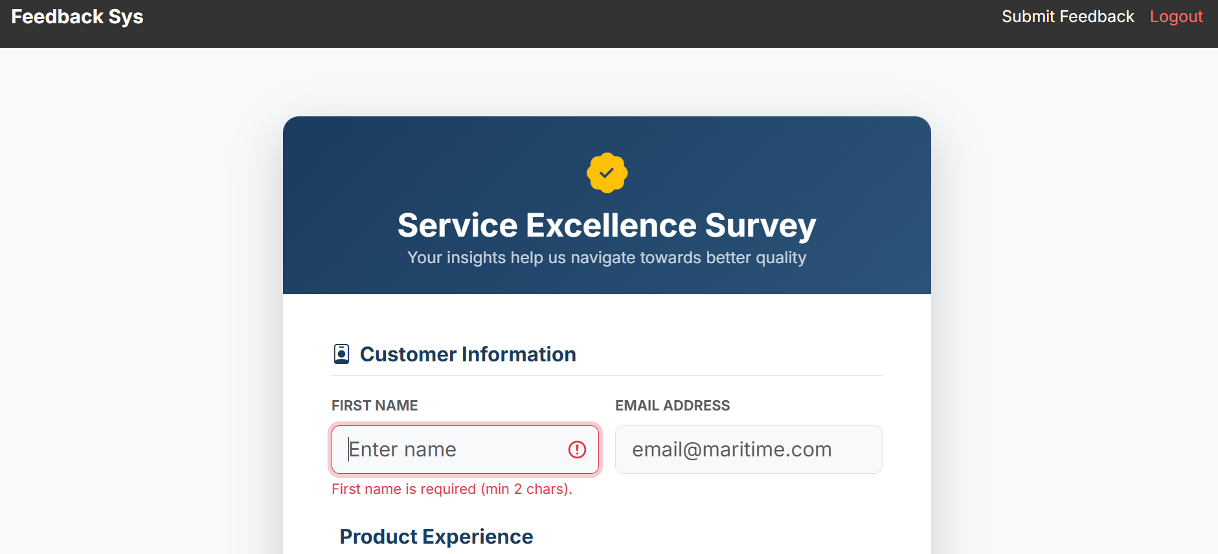
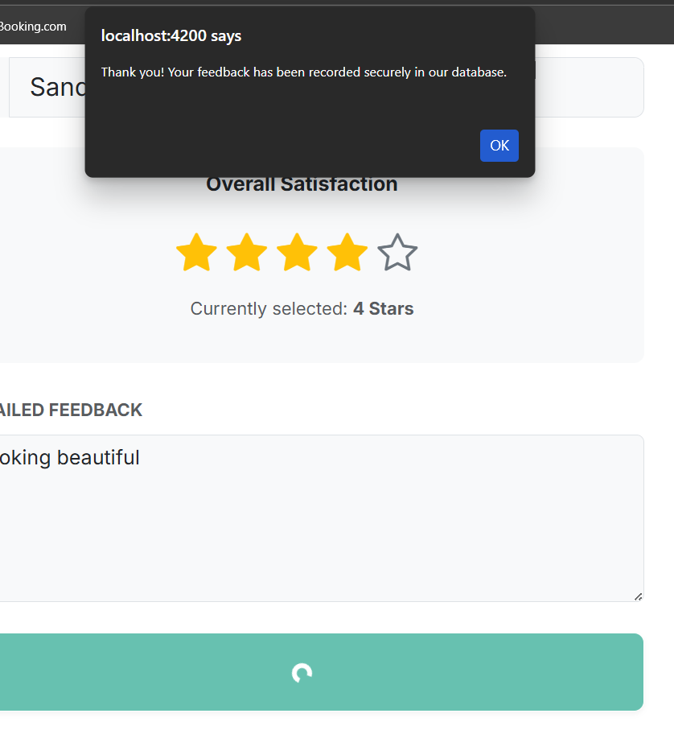
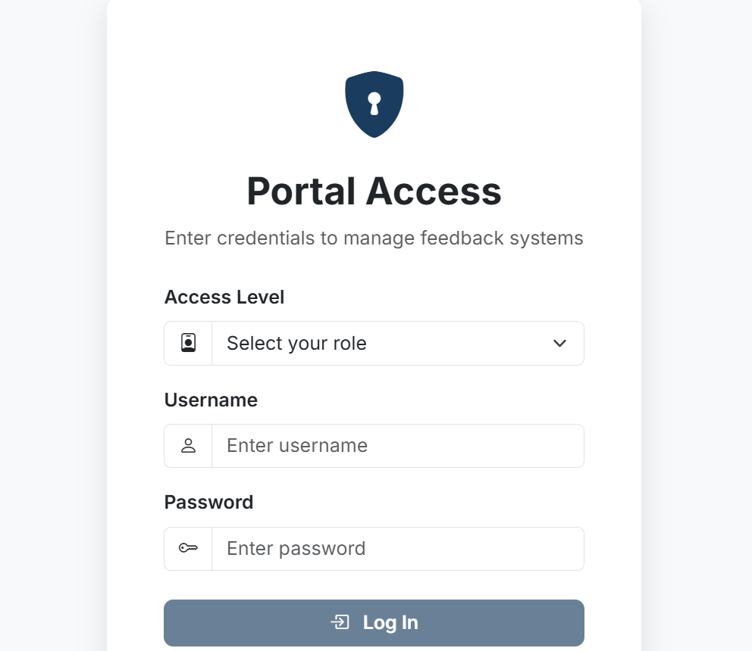
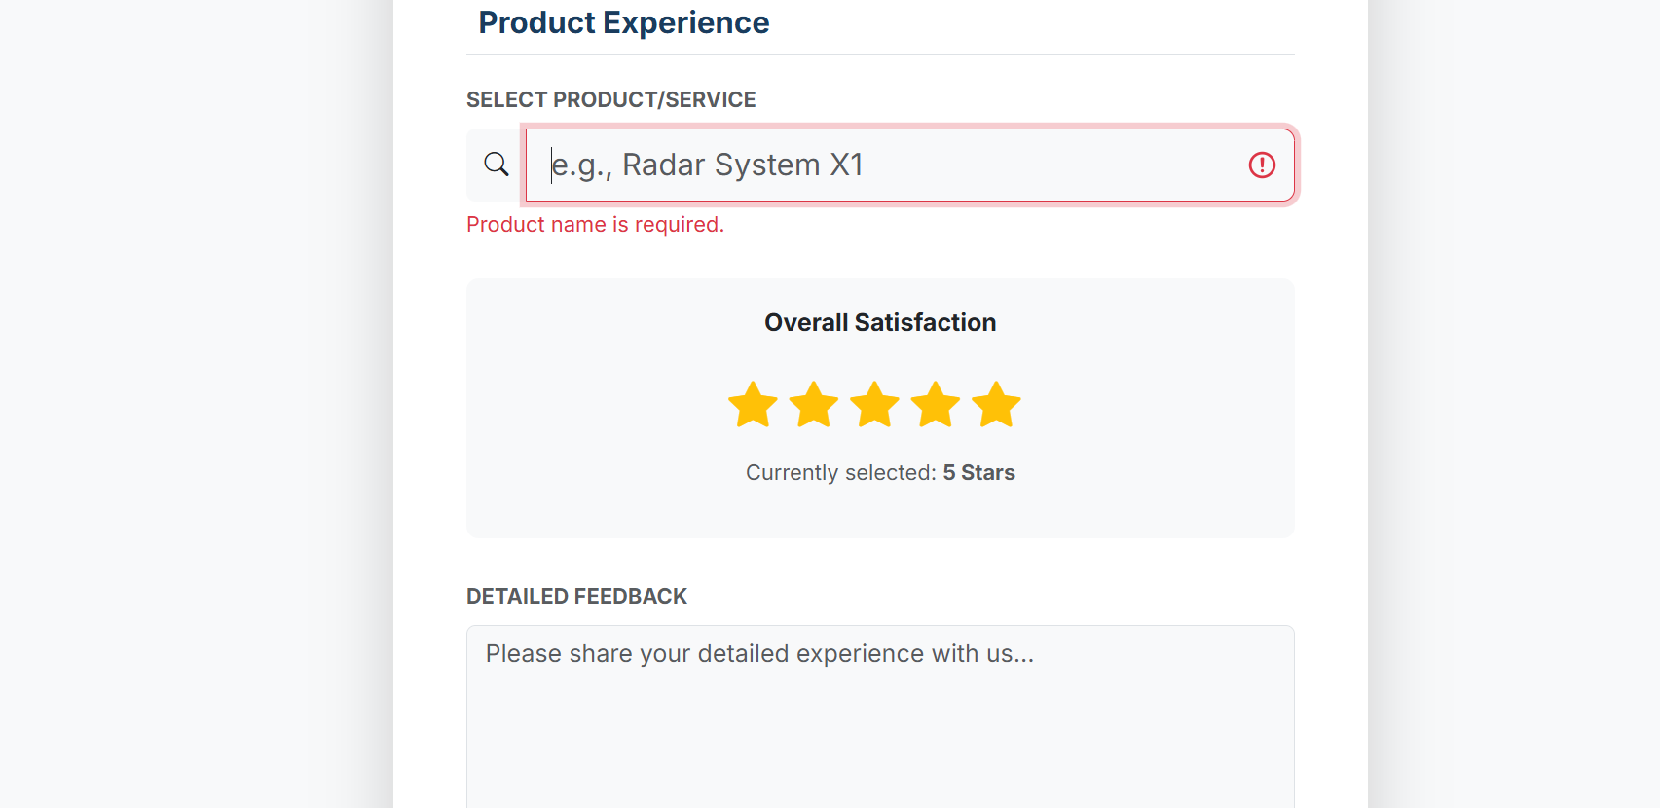

Customer Feedback Management System
Application Screenshots
Feedback Form
Feedback Submitted Message
Login Page for User & Admin
2024 - RPS Consulting all rights reserved

Slide 14
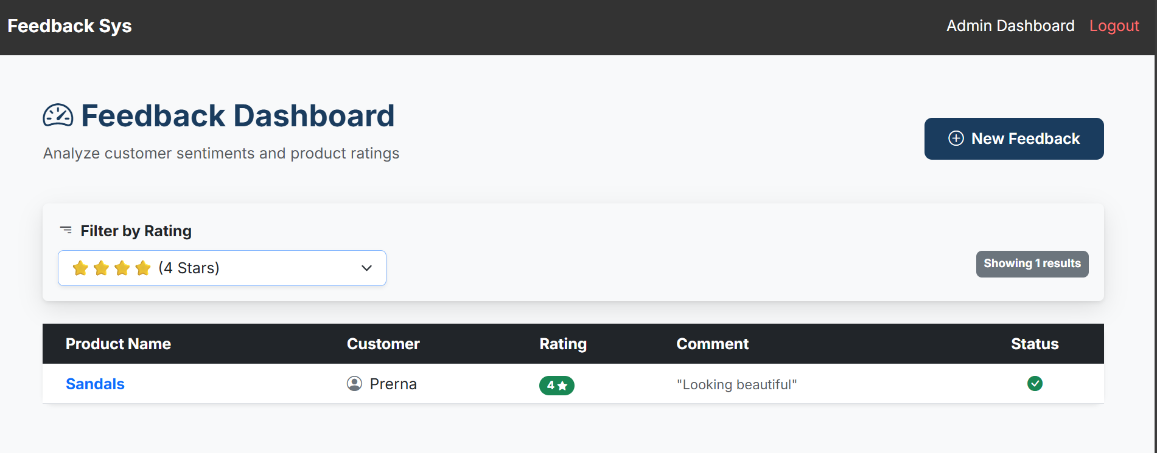
Customer Feedback Management System
Application Screenshots
Admin dashboard to view & filter feedback
2024 - RPS Consulting all rights reserved

Slide 15
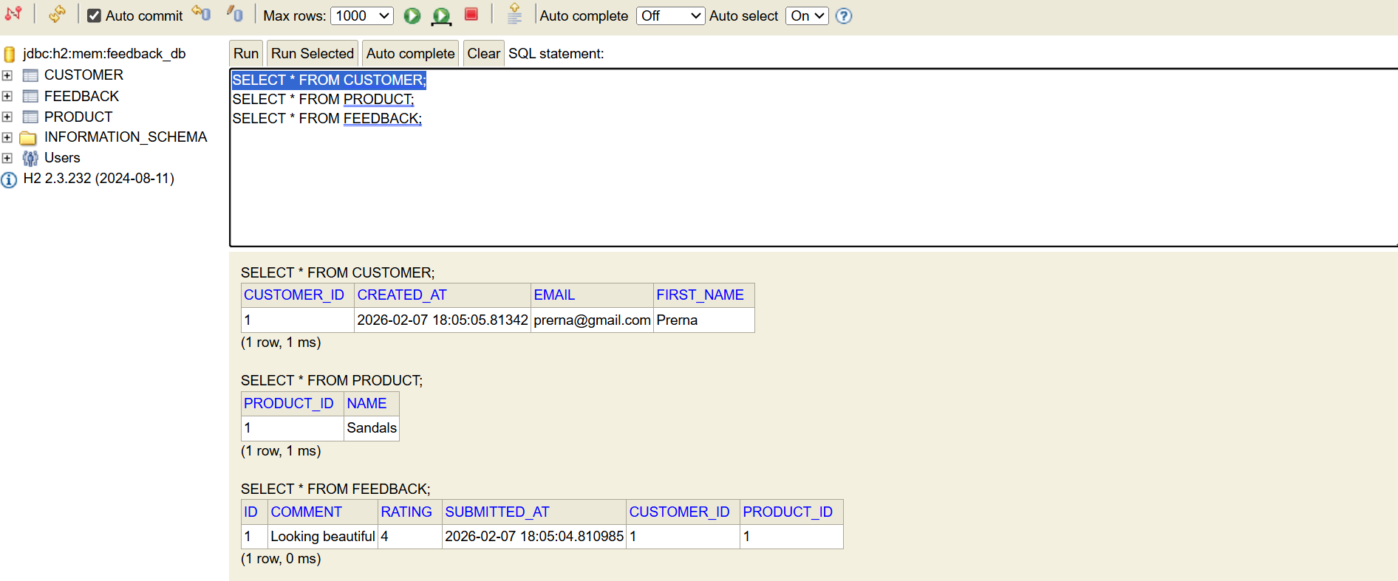
Customer Feedback Management System
Application Screenshots
Data Storing at database
2024 - RPS Consulting all rights reserved

Slide 16
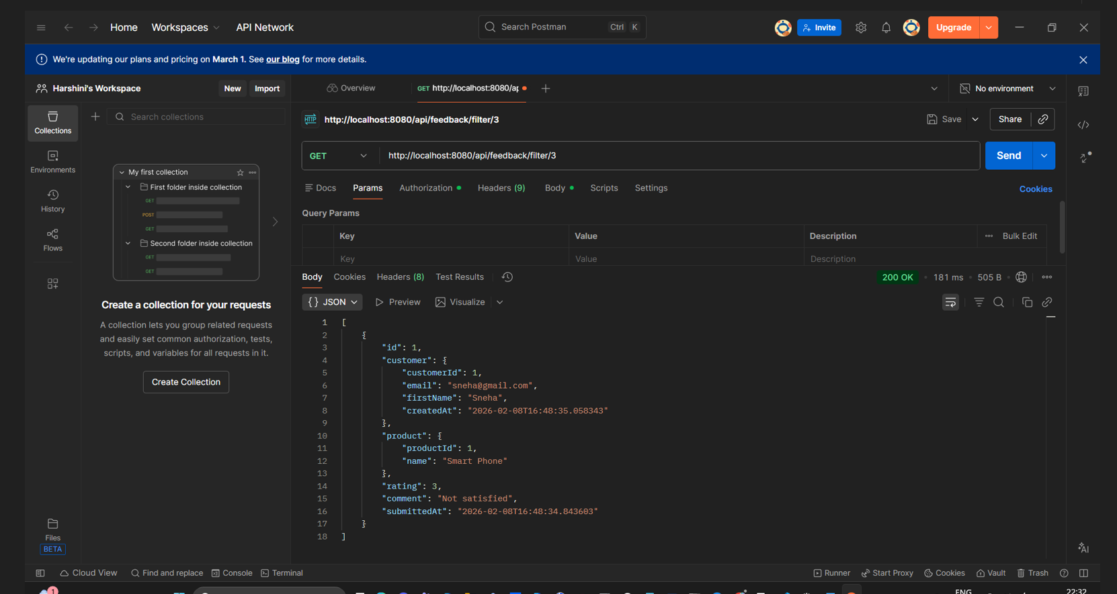
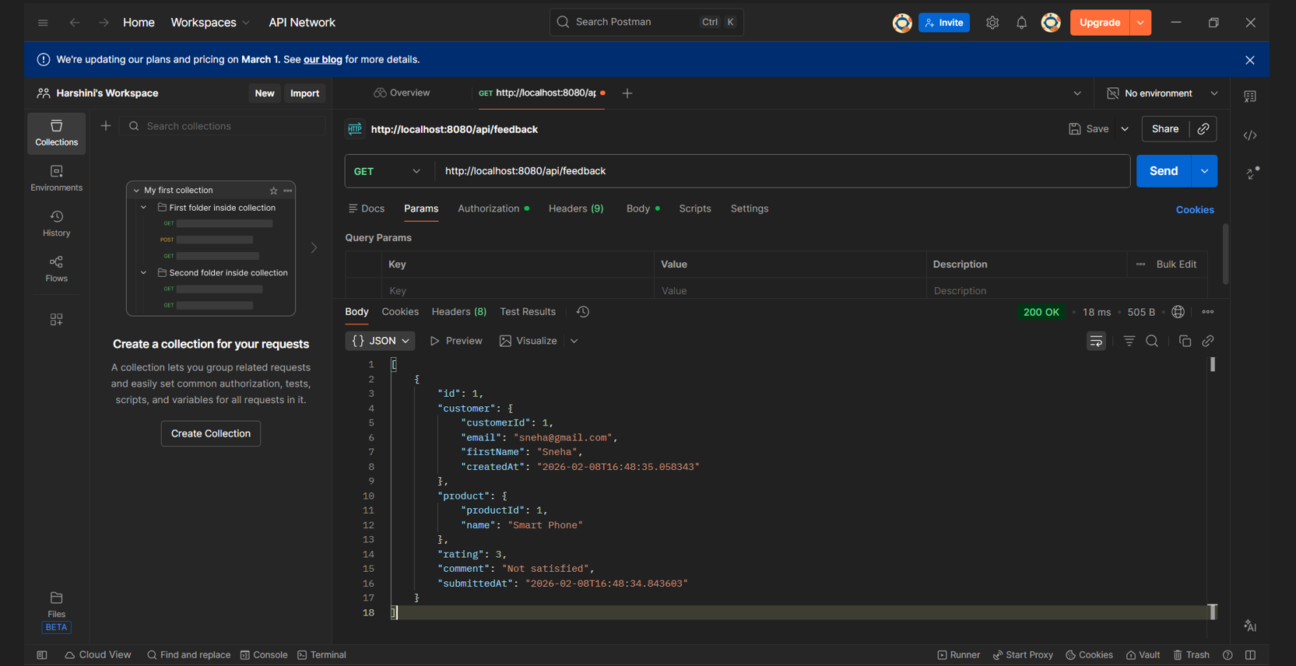
Customer Feedback Management System
Postman Screenshots
2024 - RPS Consulting all rights reserved

Slide 17
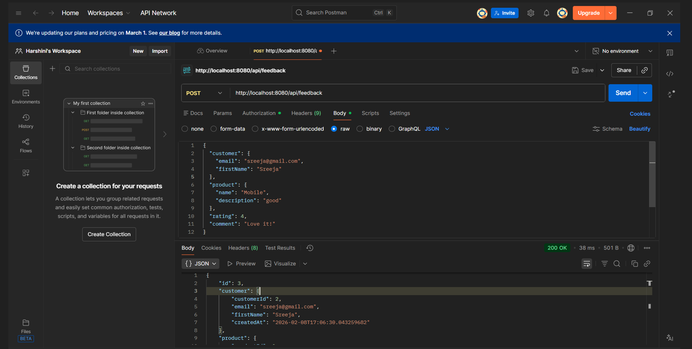
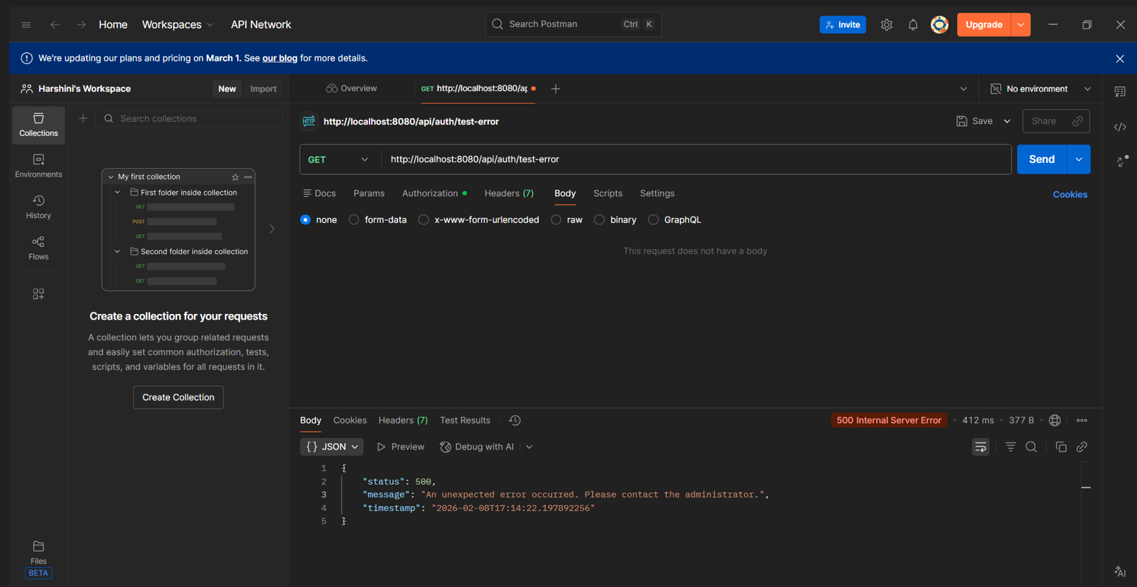
Customer Feedback Management System
Postman Screenshots
2024 - RPS Consulting all rights reserved

Slide 18
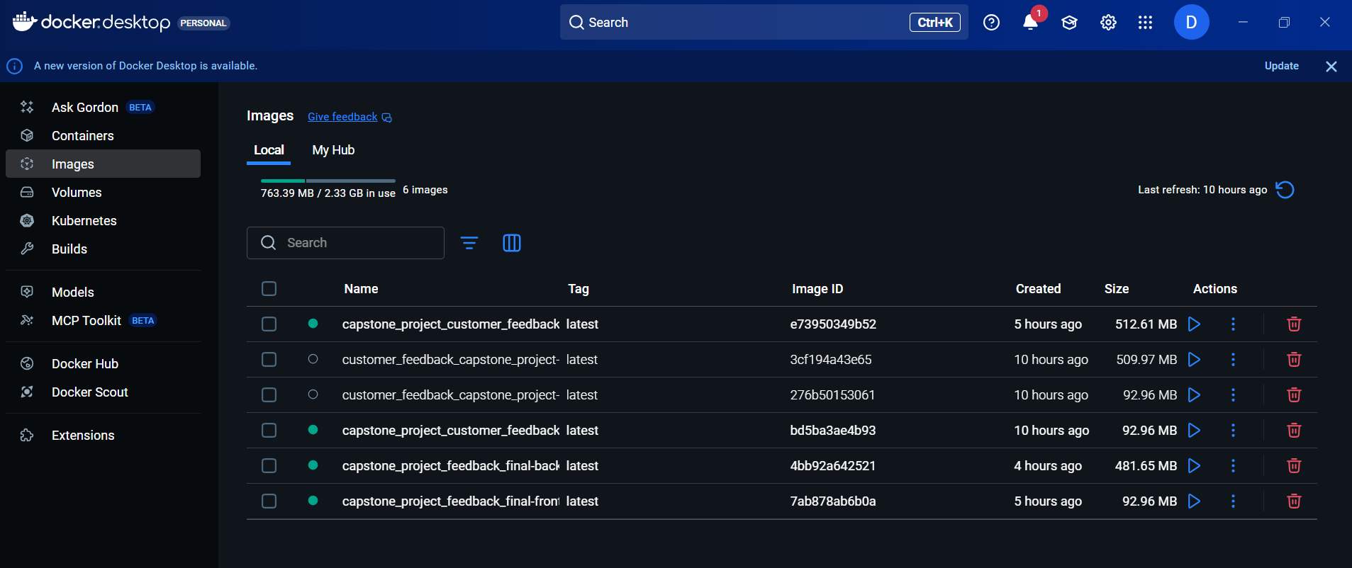
Customer Feedback Management System
Docker Deployment
2024 - RPS Consulting all rights reserved

Slide 19
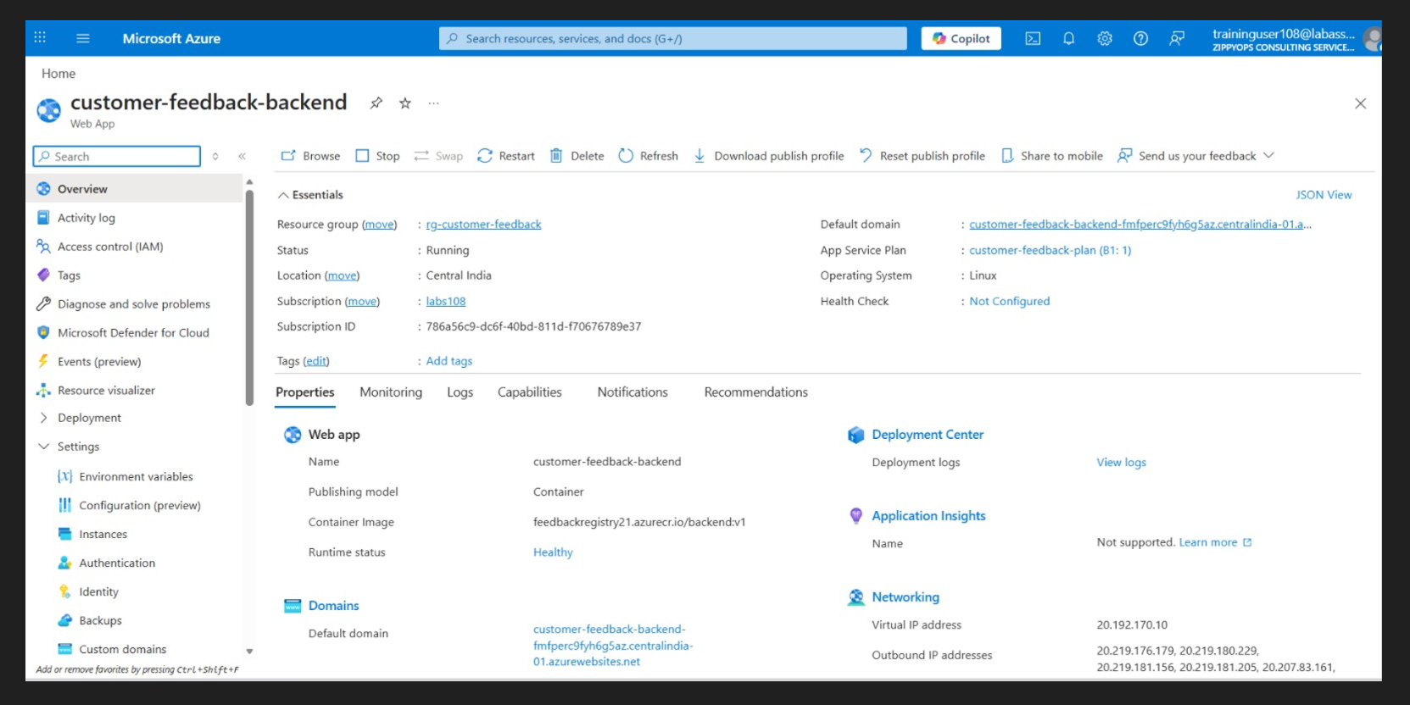
Customer Feedback Management System
Azure Deployment
2024 - RPS Consulting all rights reserved

Slide 20
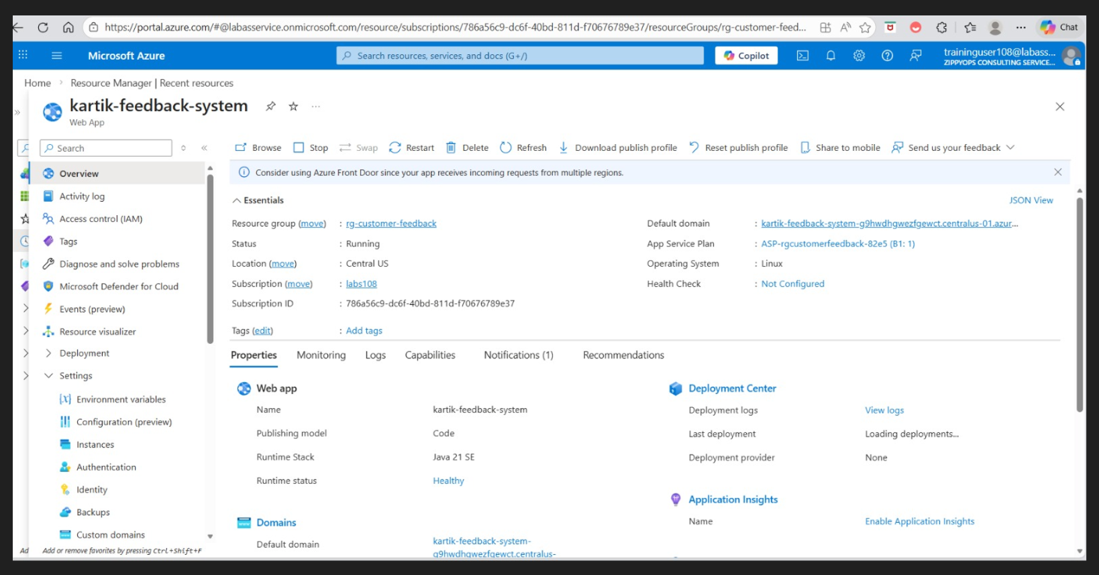
Customer Feedback Management System
Azure Deployment
2024 - RPS Consulting all rights reserved

Slide 21
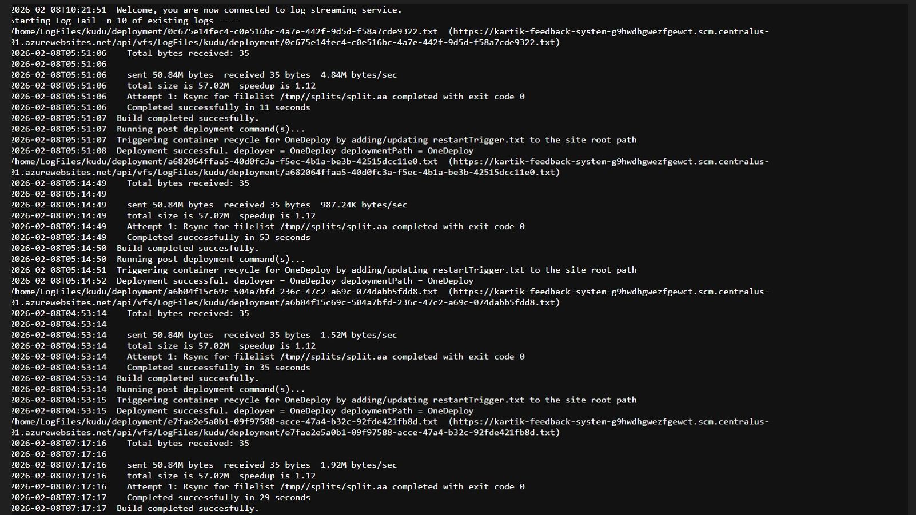
Customer Feedback Management System
Azure Deployment
https://kartikfrontend1770533220.z19.web.core.windows.net/login
https://kartik-feedback-system-g9hwdhgwezfgewct.centralus-01.azurewebsites.net/api/feedback
2024 - RPS Consulting all rights reserved

Slide 22
Customer Feedback Management System
Conclusion & Future Enhancements
Conclusion:
Successfully built a full-stack feedback management system
Secure authentication and real-time feedback storage implemented
Improved customer feedback collection and analysis through a centralized platform
Future Enhancements:
Add feedback analytics dashboards
Implement role-based authorization
Add email notifications
Integrate JWT security
2024 - RPS Consulting all rights reserved

Slide 23
THANK YOU
2024 - RPS Consulting all rights reserved

